Slide 1
Types of Energy
Forms of Energy
Gateway – Energy and the Environment
© 2011 Project Lead The Way, Inc.

Slide 2





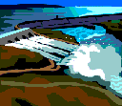
Energy
Energy exists in many forms.
Energy can be moved from one object to another.
Energy can be changed from one form to another.
Energy cannot be created or destroyed.

Slide 3





What is Always Present
But Never Visible?
ENERGY
Although energy isn’t visible,
you can detect evidence of energy.

Slide 4
Law of Conservation of Energy
With every transformation, some energy is converted to less useful forms. Energy conversions are not 100% efficient. The energy output for the intended purpose is seldom the same as the energy we put in.
95 J heat out
100 J electricity in
5 J light out
Notes:
Energy in a system may take on various forms (e.g. kinetic, potential, heat, light). The law of conservation of energy states that energy may neither be created nor destroyed, but can change its form. Therefore the sum of all the energies in the system is a constant.
An incandescent light bulb is only 5% efficient as a lighting device. It would be more efficient as a heater! All of the energy remains, but a lot is converted to “waste” form.

Slide 5
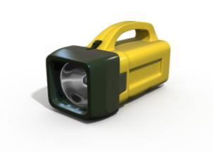
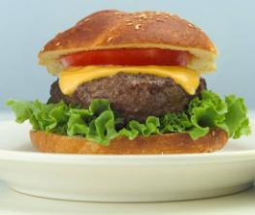
Potential Energy
The energy in matter due to its position or the arrangement of its parts
Notes:
The two types of energy are kinetic and potential.
Various forms of Potential energy include:
Elastic – A trampoline resists being stretched out of shape
Electrical – A battery operated flashlight converts electrical potential energy into light when turned on
Gravitational – Like an apple falling from a tree
Chemical – Energy in food is used by our bodies to move; in a lighted firecracker it is used to make a loud sound and scatter pieces of the firecracker

Slide 6











Kinetic Energy
Energy of a moving object
Notes:
The two types of energy are kinetic and potential.
Increase students’ awareness of kinetic energy by having them:
-- Identify objects in motion around them
-- Compare how various objects move (walk, roll, jump, etc.)
-- Analyze whether stationary objects are really moving (i.e., a plant)

Slide 7
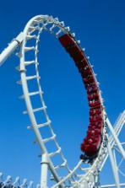
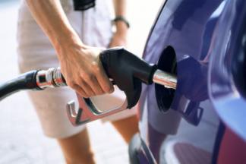
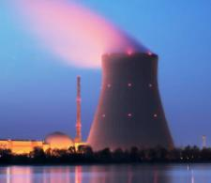
Six Forms of Energy
Mechanical
Chemical
Electrical
Light/Radiant
Heat/Thermal
Nuclear

Slide 8
Mechanical Energy
Energy that moves objects from place to place
You use mechanical energy when you kick a ball or turn the pedals of a bicycle
Other examples include water flowing in a stream, tires rolling down a road and sound waves from your iPod.

Slide 9
Chemical Energy
Energy released by a chemical reaction
The food you eat contains chemical energy that is released when you digest your meal
Wood, coal, gasoline, and natural gas are fuels that contain chemical energy
Notes:
Wood, coal, gasoline, and natural gas are fuels that contain chemical energy. When these fuels are burned, the chemical energy is released as heat.

Slide 10
Electrical Energy
Energy that comes from the electrons within atoms
It can be generated at a power plant or inside a battery and can power everything from remote-controlled cars to refrigerators
Lightning and static electricity are also forms of electrical energy

Slide 11
Heat (Thermal) Energy
Energy created by the motion of atoms and molecules that occurs within an object
Thermal energy exists when you heat a pot of water on a stove
Notes:
For example, when you heat a pot of water on a stove, the heat from the burner adds energy to the water, causing the water molecules to move around more rapidly, increasing the water’s thermal energy.

Slide 12

Nuclear Energy
Energy contained in the nucleus of an atom
Nuclear energy is released when nuclei are split apart into several pieces, or when they are combined to form a single, larger nucleus
Notes:
An atom's nucleus can be split apart. When this is done, a tremendous amount of energy is released. The energy is both heat and light energy. This energy, when let out slowly, can be harnessed to generate electricity. When it is let out all at once, it can make a tremendous explosion in an atomic bomb.
The word fission means to split apart. Inside the reactor of an atomic power plant, uranium atoms are split apart in a controlled chain reaction. In a chain reaction, particles released by the splitting of the atom go off and strike other uranium atoms splitting those. Those particles given off split still other atoms in a chain reaction. In nuclear power plants, control rods are used to keep the splitting regulated so it doesn't go too fast.
Another form of nuclear energy is called fusion. Fusion means joining smaller nuclei (the plural of nucleus) to make a larger nucleus. The sun uses nuclear fusion of hydrogen atoms into helium atoms. This gives off heat and light and other radiation.

Slide 13
Light (Radiant) Energy
Energy that can move through empty space
The sun and stars are powerful sources of radiant energy
The light given off by light bulbs and campfires are also forms of radiant energy

Slide 14
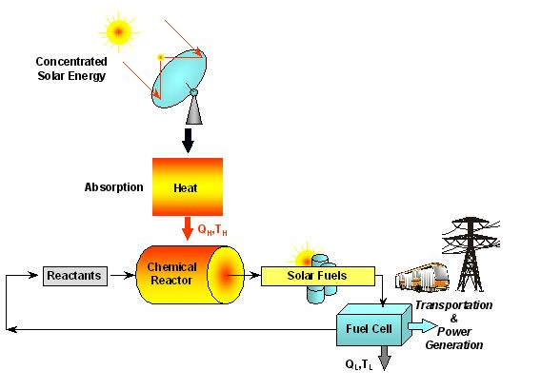
Energy Conversion
All forms of energy can be converted into other forms of energy
Notes:
For example: concentrated solar radiation is used as the energy source of high-temperature process heat for driving thermochemical reactions towards the production of storable and transportable fuels.

Slide 15


Energy Forms
These forms of energy do work that end up as motion, light, or heat.
Energy is used to power manufacturing, light buildings, propel vehicles, and communicate messages.
What else do we use energy for?

Slide 16
Image Resources
Microsoft, Inc. (2009). Clip Art. Retrieved March 24, 2009, from http://office.microsoft.com/en-us/clipart/default.aspx
ETH – Renewable Energy Carriers (2010). Professorship of Renewable Energy Carriers. Retrieved May 5, 2010, from http://www.pre.ethz.ch/research/projects/?id=solarfuels

